Slide 1
3D racing web game
By Tamer Hussen

Slide 2
Task
To create and present a 3D web game and website using HTML, CSS and JS.

Slide 3
Progress / Prototype Demonstration Key Points:
Game Website Design
Introduction page Login page New user registration page 404 error page Game loading page Game pages Basic, correct hyperlinks to all pages
Game Assets
Character design Landscape/environment design Enemy design (if applicable)
Game Material Design:
Light design Texture design Material for game assets
Game Animation:
Animation of game assets
Game Interaction:
User interaction with game objects
Game UI:
UI overlay for scores and life state
Game Mechanism:
Fully functioning UI displaying player statistic
Responsive Design:
Web page is rendered according to the window size Game page is rendered according to the window size Demonstrate both text and image responsive design

Slide 4


Final Demonstration Key Points:
Server-Side and Deployment:
Game has server-side implementation and is correctly deployed using Node.js 404 page is deployed correctly
Fully Working Game Website:
Functional login and registration web interface Website is responsive to different screen sizes All webpage code follows responsive design standards
Data Storage Implementation:
User login data is structured and saved on the server side Game score is structured and saved on the server side Player login data and game score can be reloaded correctly Game data storage is secured and inaccessible without authentication
Game Visual and Performance:
Complex landscape with customized geometry/objects and visual effects Game level or difficulty increases with user score Game audio is working and can be used in the game Game is functional in the latest Google Chrome browser for both PC and mobile devices
Game Features:
"Readme" documentation:
How to play the game Game project folder structure Key points achieved
Game has a restart button that works correctly Game loading page is fully functional

Slide 5
Advanced Demonstration Key Points: | Video Submission Requirements:
User Data and Security: User data is encrypted and stored securely on the server side Database Design and Game Data: Database design and implementation for game data Multiplayer Functionality: Game supports at least two players playing in the same game simultaneously Physics Physics that affect the game (e.g., gravity, collision detection) Game Messaging and Communication: Systematic game messaging design Passing data using appropriate client-server communication methods correctly | Video Content: 40-50 seconds raw game demonstration at the beginning without any annotation Exported in MP4 format for compatibility with most video players Video Duration: 3-4 minutes in total duration Demonstrate key aspects of your work Serve as a showcase portfolio piece

Slide 6
Game Type and description
Type: racing simulator game
Description: Players will race and avoid obstacles to gain a high score.

Slide 7
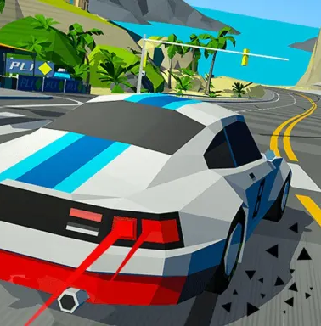
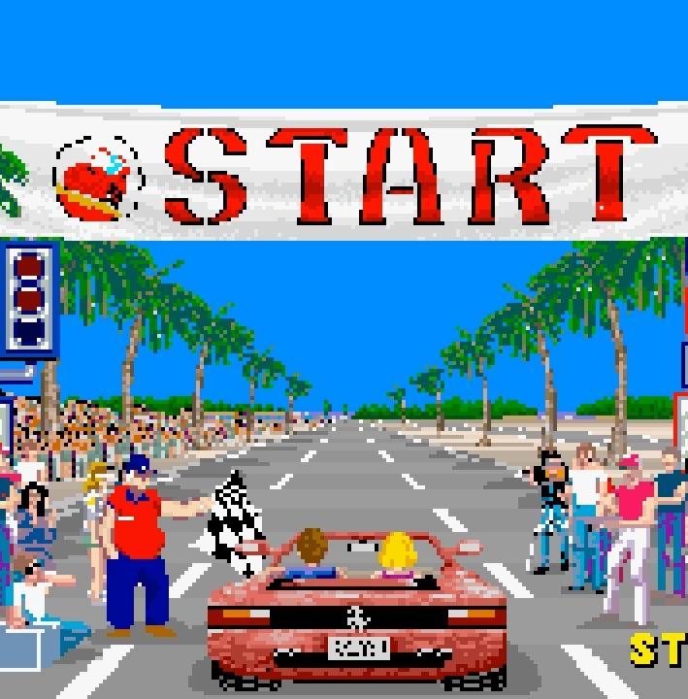
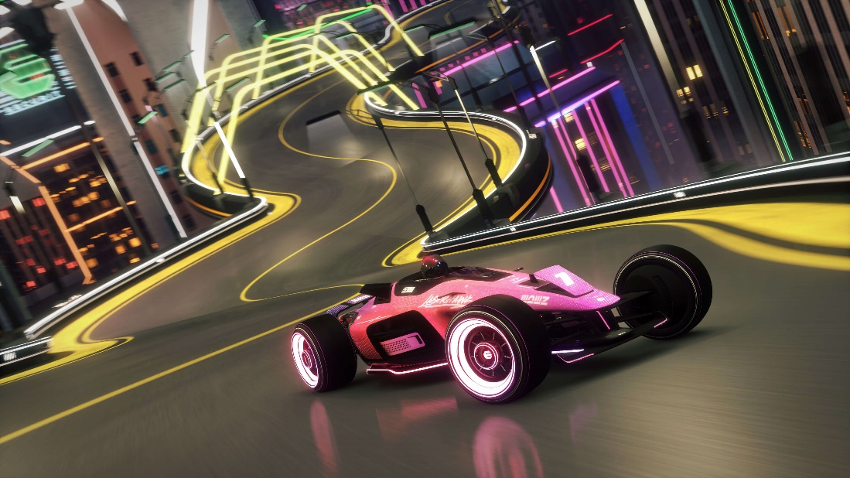
Image examples
Image 1 - style
Image 2 - gameplay
Image 3 - FOV

Slide 8

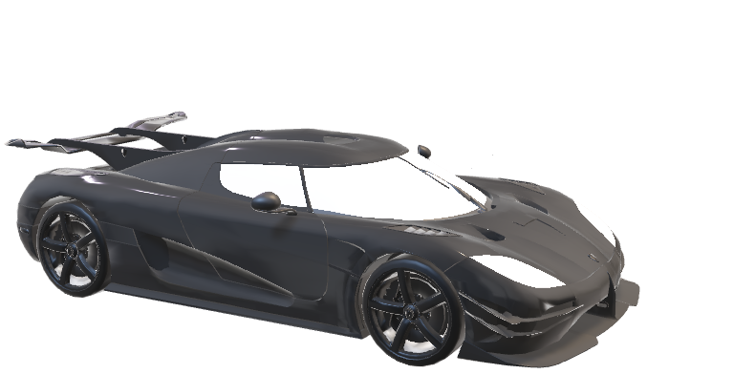
assets
Player character - car
Sky box - Forest

Slide 9
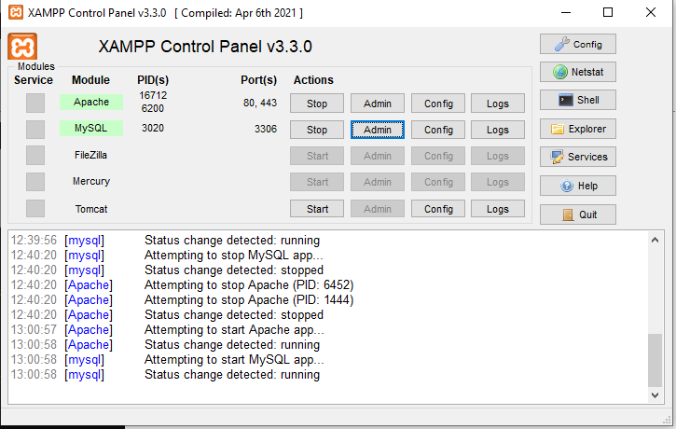
Server Set up
Install Portable Software
Download Node.js Portable and XAMPP Portable.
Extract them into a folder of your choice.
Set Up Node Project
Open a terminal in your project folder.
Run: npm init –y.
Create a server.js file in your visual studio code.
Start MySQL Database
Open XAMPP, start MySQL
Create a database for your project using phpMyAdmin.
Install Packages
Run: npm install express mysql.
Start the Server
Run: node server.js.
Open http://localhost:3000 in your browser to view your project.
Image example of XAMPP to start server

Slide 10
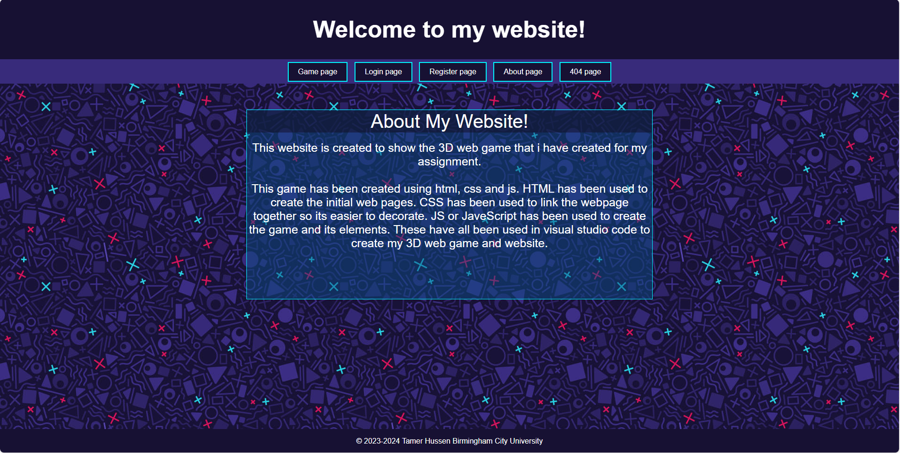
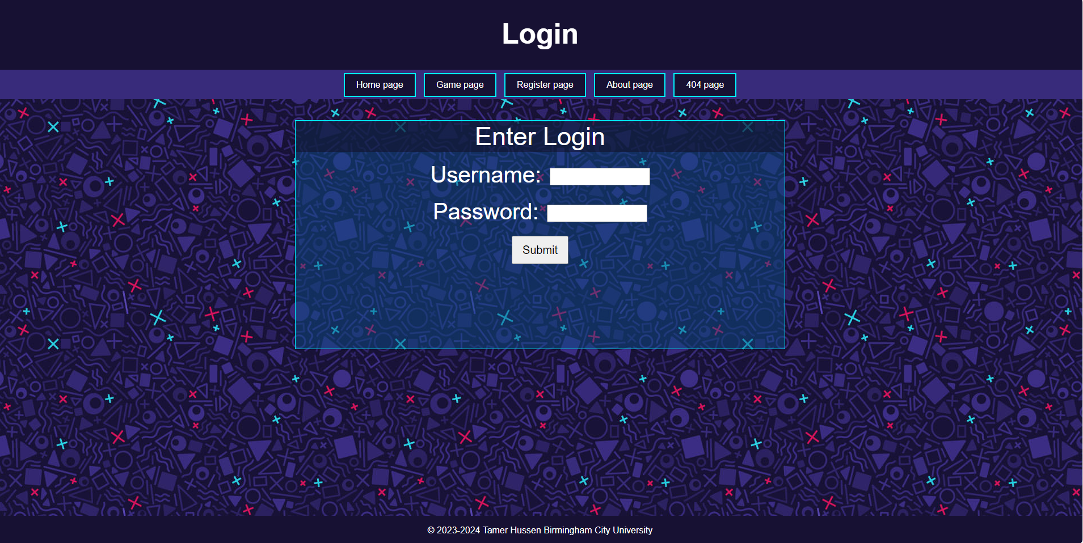

Website preview
Image 1 – home page of website
Image 2 – login page of website
Image 3 – 404 page of website

Slide 11
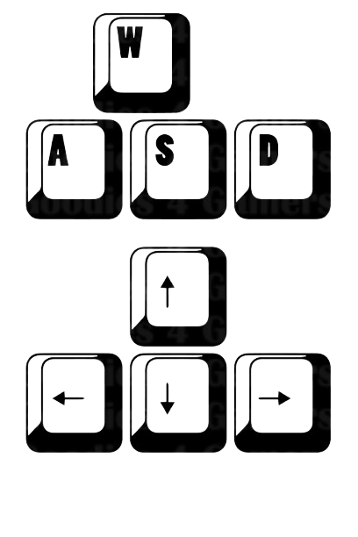
Game Controls
A
A
C
B
D
C
A
D
Controls – [A] Forward, [B] slow down / stop , [C] Left, [D] right

Slide 12
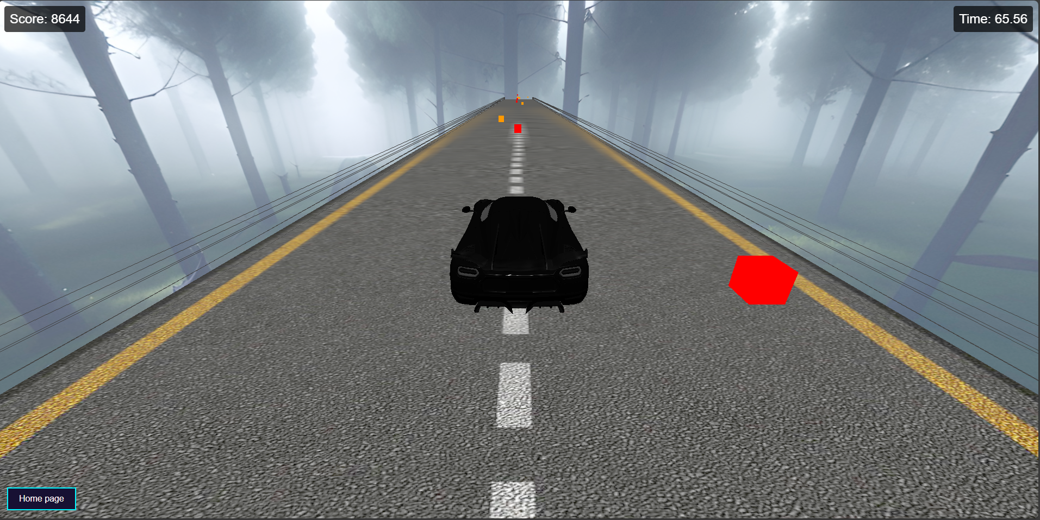
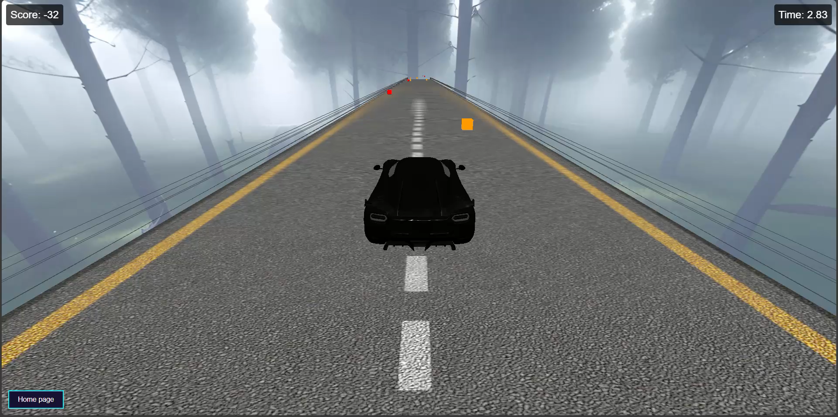
Game preview
A
A
A
C
B
C
D
Image 1 – [A] game UI, [B] player character, [C] obstacles, [D] home button
video 1 – preview of game

Slide 13
references
3D Models for Free - Free3D.com
- 3D models
Sketchfab
- Skybox
Three.js – JavaScript 3D Library
- JavaScript codes
https://youtu.be/faHxj0RYLZE
- Code assist
W3Schools Online Web Tutorials
- Website examples

Slide 14
Any questions?

